Slide 1
Notes:
Master Slide Templates are available as drop down selections.
Please refrain from over-populating slides. If they are so dense the copy needs to be reduced, create additional slides for ease of legibility.

Slide 2
Austin Watters
Backlash Whiplash
Effective Communication Through the Noise
Downtown Development Coordinator, Downtown Florence, SC
Notes:
Recommended font style and sizes for legibility
Title text: Arial, 36pt, all caps
Body text: Arial, 24pt-28pt

Slide 3
AGENDA
Promotion VS Communication
Roles and Responsibilities
Theory Overview
Inoculation
Social Judgment
Cognitive Dissonance
Case Studies
Audience and Channels
Message Craft
Notes:
Recommended font style and sizes for legibility
Body text: Arial, 24pt-28pt

Slide 4
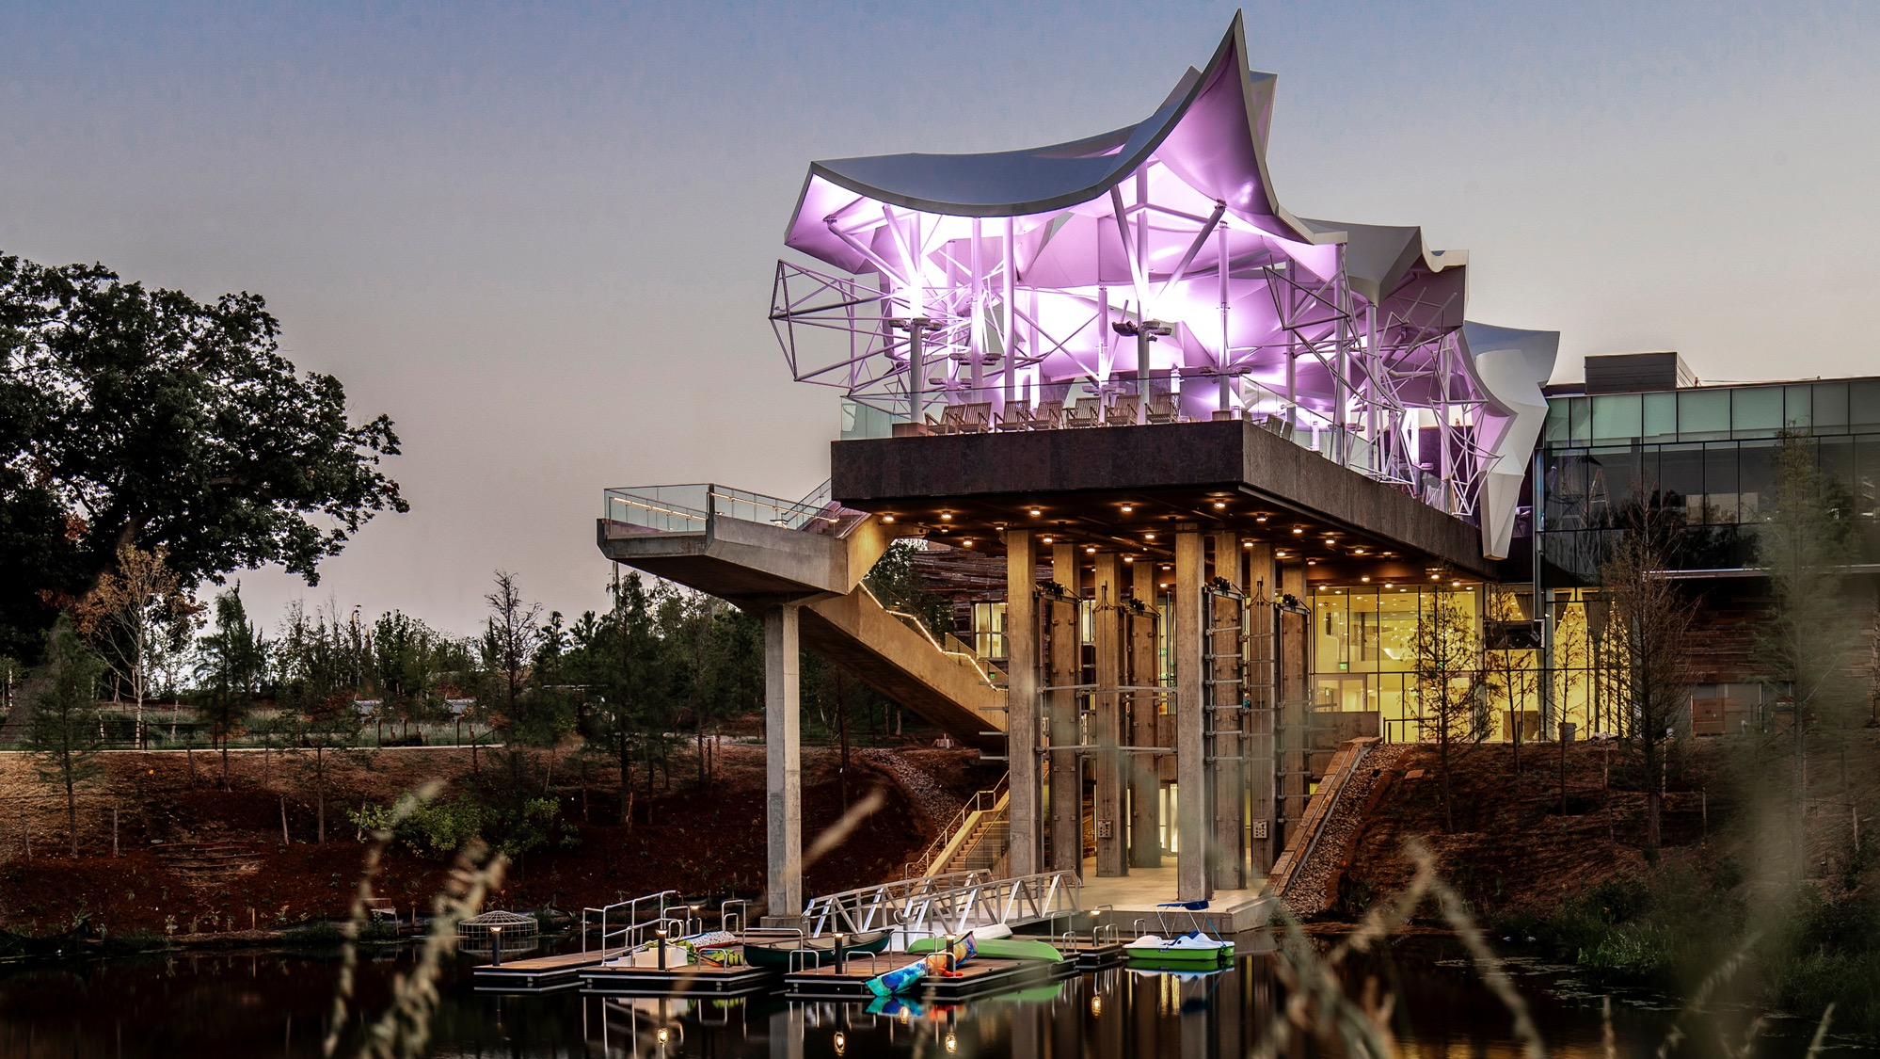
Use this slide to break up content and add an important point.
You just hit post, naturally – here come the comments….
Notes:
You hit post… and immediately check the comments.
Whether you’re in a city office or a nonprofit…
You’re not just sharing information— you’re managing public trust.

Slide 5
Promotion VS Communication
All promotion is communication, but not all communication is promotion.
Promotion What & Sometimes When
Communication Who, When, Why, How
As Main Street practitioners, we must define meaning before the comment section invents one.
Notes:
Promotion is for ads, marketing, storytelling, positioning
Communication is for traffic changes, announcements, information sharing, updates, explanations
Online audiences are very creative

Slide 6
Communicating as Government & Nonprofit
Government Housed Main Street
Higher Authority
High Scrutiny
Potentially Low Trust
Slower approval process, more hands in the pot
Nonprofit Housed Main Street
Higher Social Authority
Flexibility
Closer business to business relationships
Intermediary
Both are expected to explain / Justify Change
Notes:
Ask who is gov housed and who is nonprofit housed
Communication from the two entities can and should look different
Prepare for theoretical practice and apologize for text heavy slides

Slide 7
Inoculation Theory
Inoculation Theory is the idea that people can build resistance to persuasion by being exposed to a weaker version of an argument before encountering a stronger one.
Think of it like a Vaccine
Introduce a potential challenge
Address it early
Audience should become less susceptible to opposing messages later
A small dose of an idea early and often makes change easier to digest
Notes:
If your audience hears about something from someone else first, especially in a negative or incomplete way, that version becomes their starting point.
So your job is to:
Introduce the topic early
Acknowledge likely concerns upfront
Frame what it means before others do
inoculation in practice:
You don’t wait
You name concerns
You shape the lens

Slide 8
Social Judgment Theory
Social Judgment Theory explains how people evaluate new information based on their existing beliefs and attitudes.
When people hear a message, they sort it into three categories:
Latitude of Acceptance (they agree)
Latitude of Non-Commitment (unsure / persuadable)
Latitude of Rejection (they disagree strongly)
The further your message is from what someone already believes, the more likely they are to reject it outright.
Notes:
Practical Summary (Main Street Version)
Not everyone hears your message the same way.
Some people are already on board
Some are unsure
Some are firmly against it
If your message only speaks to supporters, you risk:
Ignoring concerns
Strengthening opposition
Losing the middle group that could be persuaded
In one line (slide-ready):
“You’re not talking to one audience—you’re talking to three.”
Quick Applied Example
Instead of:
“This project will be a great addition to downtown!”
Try:
“We’re excited about this project, and we also know it may not feel like a fit for everyone—especially when it comes to parking and character. Here’s how those concerns are being considered.”
That’s Social Judgment Theory in practice:
You acknowledged multiple perspectives
You spoke to skeptics—not just supporters
You kept the middle group from drifting into opposition

Slide 9
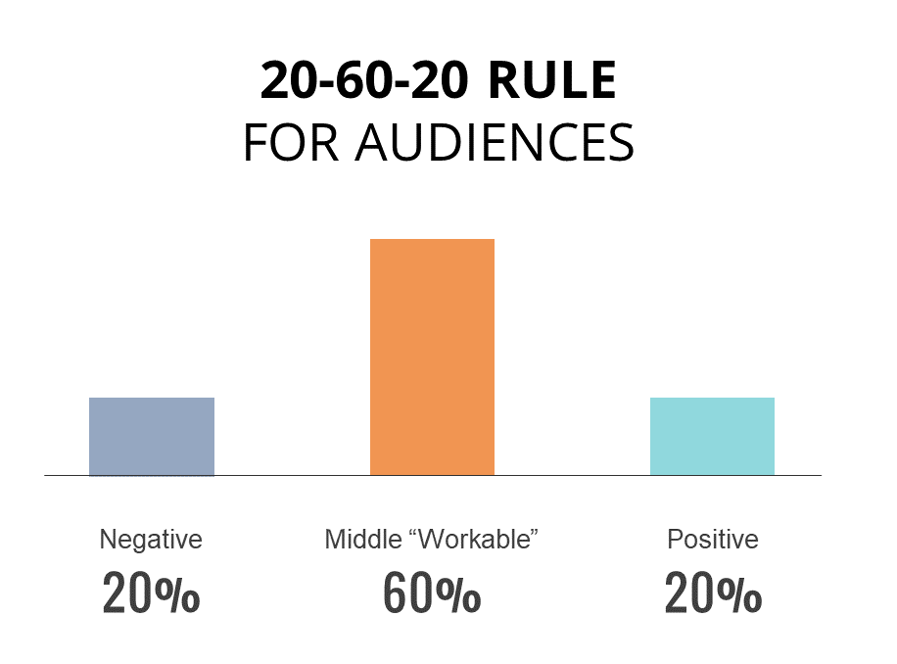

Slide 10
Cognitive Dissonance
In communication and media, Cognitive Dissonance refers to the tension people experience when new information conflicts with what they already believe, and how they resolve that tension through interpretation.
Instead of changing their beliefs, people often:
Dismiss the message
Reinterpret the message
Double down on what they already think
People don’t receive your message in a vacuum; they filter it through what they already believe about downtown.
If your message conflicts with what people believe, they won’t change their mind. They’ll change your message.
Notes:
A new hotel becomes “downtown losing its charm” A chain restaurant becomes “small businesses being pushed out” An art installation becomes “wasted tax dollars”
Instead of:
“This project will bring new investment and activity downtown.”
Try:
“This project is designed to support what people already value about downtown—local businesses, walkability, and long-term sustainability.”
Cognitive Dissonance in practice:
You aligned the message with existing beliefs
You reduced the need for people to “push back”
You made it easier to accept, not resist

Slide 11
Stack all Three Theories Together
Inoculation → Say it first
Social Judgment → Say it for different audiences
Cognitive Dissonance → Say it in a way people can accept

Slide 12
Case Studies

Slide 13
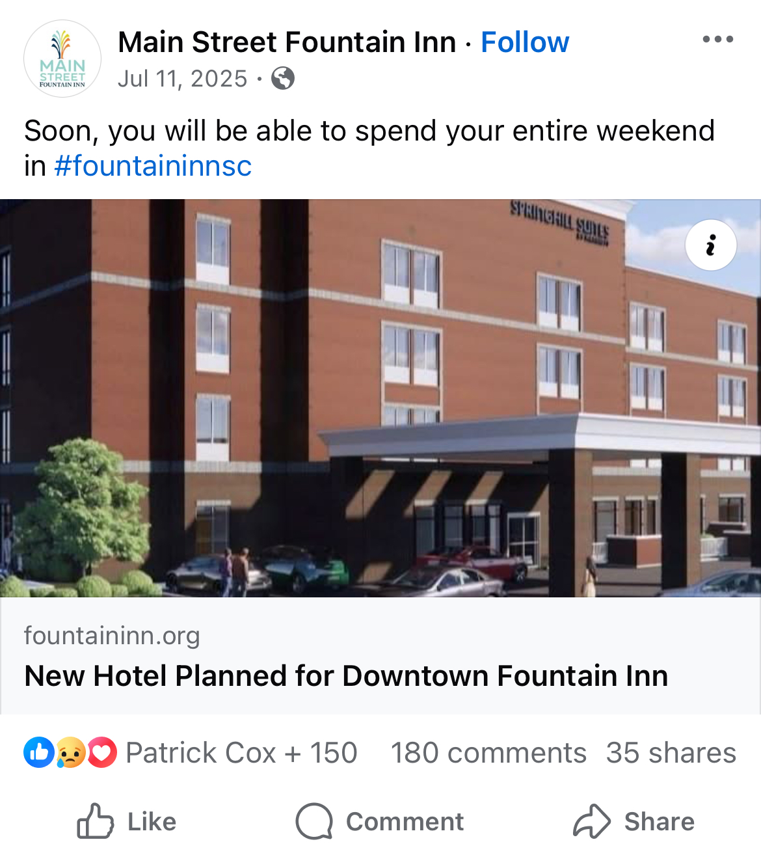
Case Study 1 – Hotel Announcement
Metrics
150 Interactions
180 Comments
35 Share
Basic Stats
15,423 Residents
Greenville, SC Metro area – 1 Million Residents
Fountain Inn is a rapidly expanding suburb known for its historic Main Street, community festivals, and easy access to I-385.
Template with Photo on left
Notes:
So, what do you think the comments looked like?

Slide 14
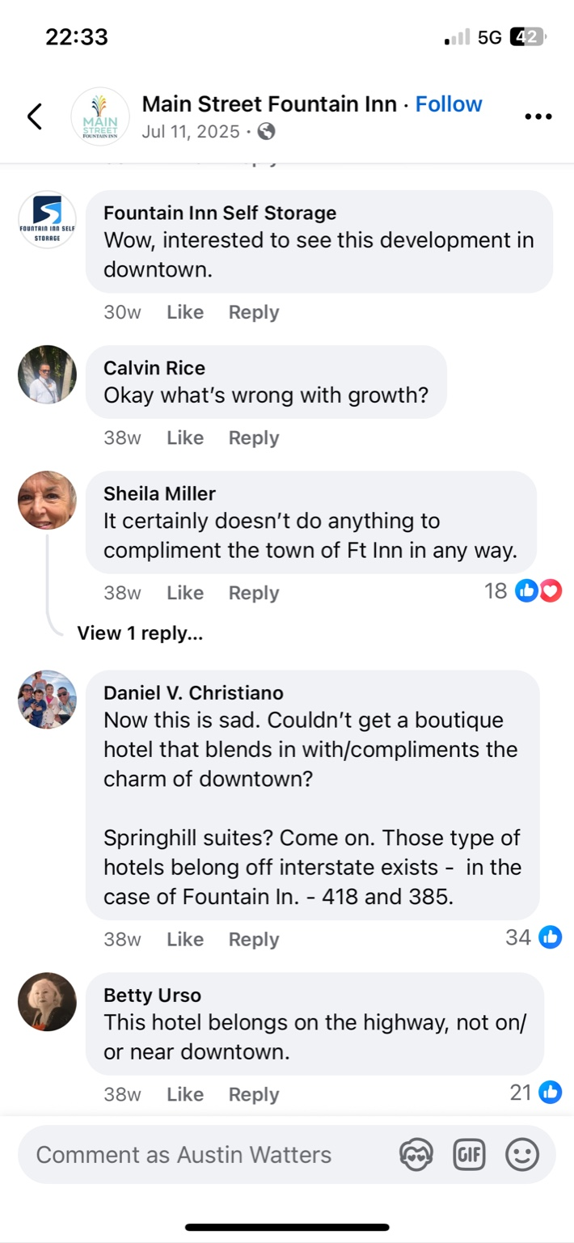
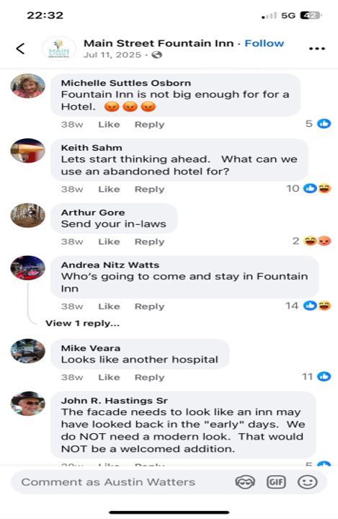
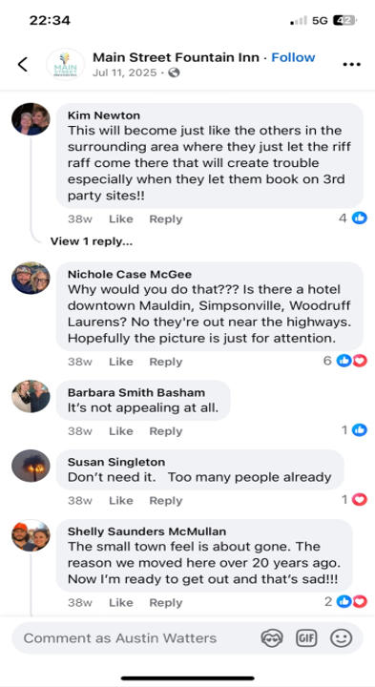
Notes:
Read comments
So these look like a bunch of different comments, but its actually not.
These aren’t a bunch of different problems, its one showing up in different ways.
Let’s talk about it.

Slide 15
C.1 What Went Wrong
Design Matters
The reaction isn’t about the hotel.
Identity – This doesn’t fit our town
Trust – Why is this happening
Fit – This belongs somewhere else
Impact – Who is this for
What’s missing
No early framing – no post leading up to the announcement
No acknowledgment of concerns
Shared from a third party – not delivered by the program
No explanation of why – the why is in the article, but most people won’t read before reacting.

Slide 16

What would you do differently?
Notes:
Tell them what you would have done.

Slide 17
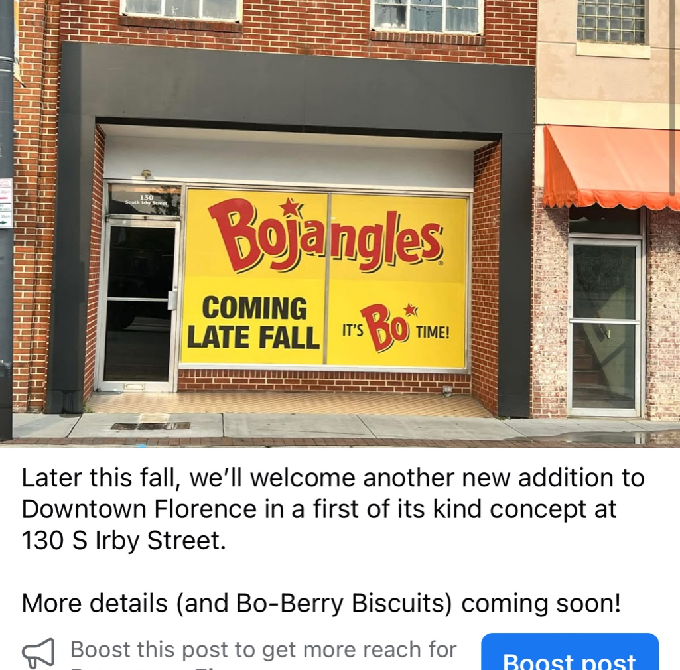
Case Study 2 – It’s Bo Time
Metrics
929 Reactions
528 Shares
549 Comments
Basic Stats
49,900 Residents
Regional hub
Former railroad town now a bustling center for healthcare, education, and industry. A revitalized downtown with a strong sense of community.

Slide 18
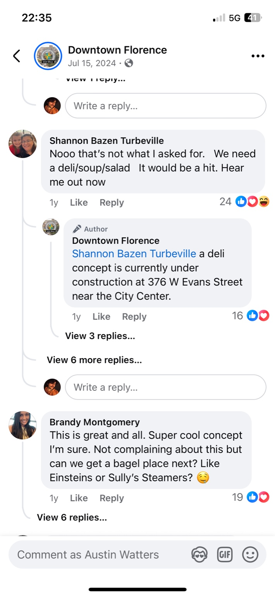
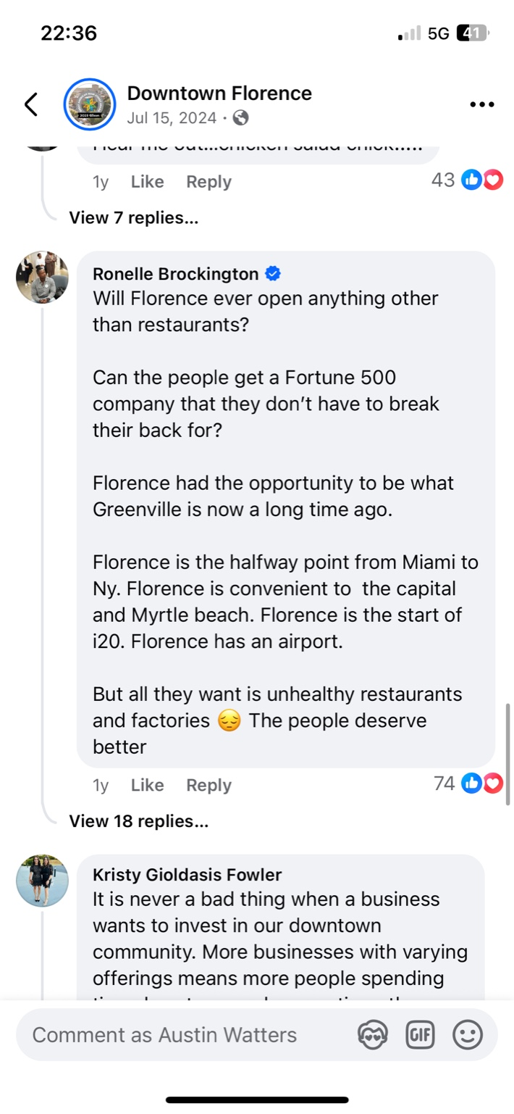
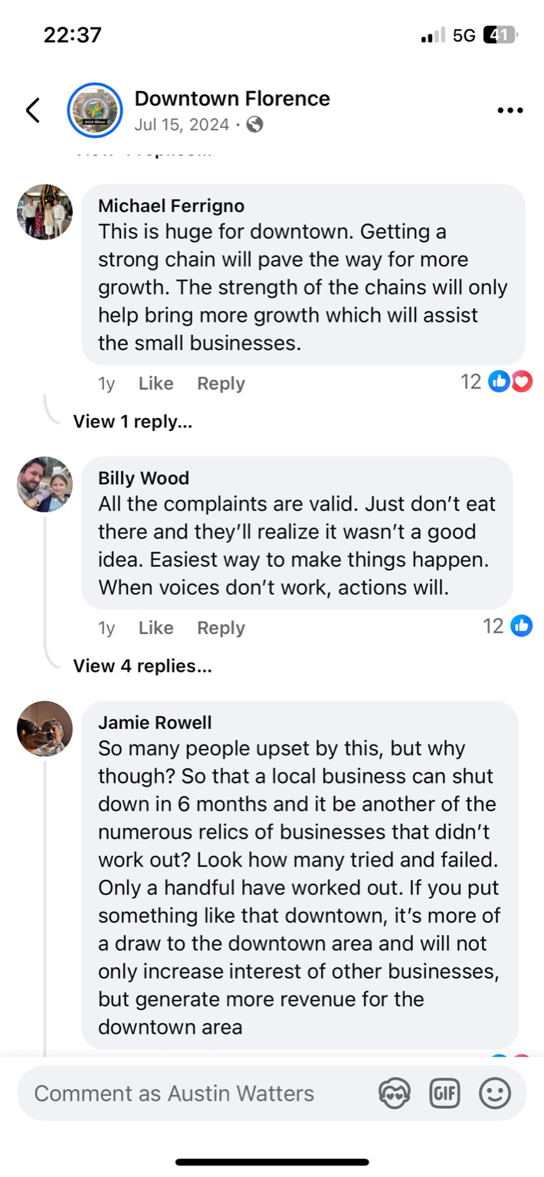
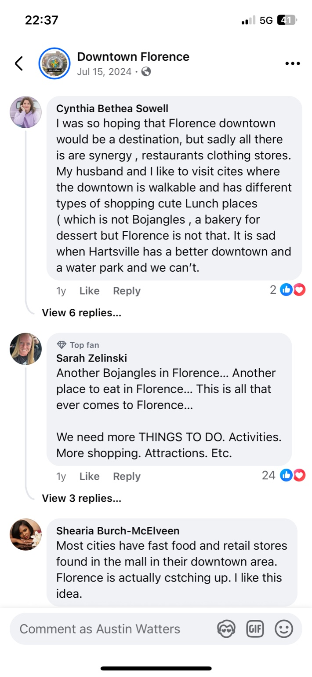
Notes:
Skeptical:
“We need something different.”
“Why another restaurant?”
“Downtown should be local.”
Supportive:
“This is huge for downtown.”
“Better than an empty building.”
“Growth brings more growth.”
Neutral / Redirecting:
“Can we get a deli next?”
“What about other types of businesses?”
So, what’s different here compared to the hotel example?

Slide 19
C.2 Backlash or Friction?
No singular reaction, multiple perspectives
Identity → “We want local businesses”
Growth → “Any investment is good”
Preference → “We want something different”
Practicality → “This will survive”
Why this played differently
Inoculation (partial)
Visual reveal happened first
Reduced shock
Social Judgment
All three audiences visible
No single group dominates
Cognitive Dissonance
Still present, but not overwhelming
Dialogue isn’t bad, but it can feel scary because it’s unpredictable

Slide 20
What would you do differently?
Notes:
Tell them what you would have done.

Slide 21
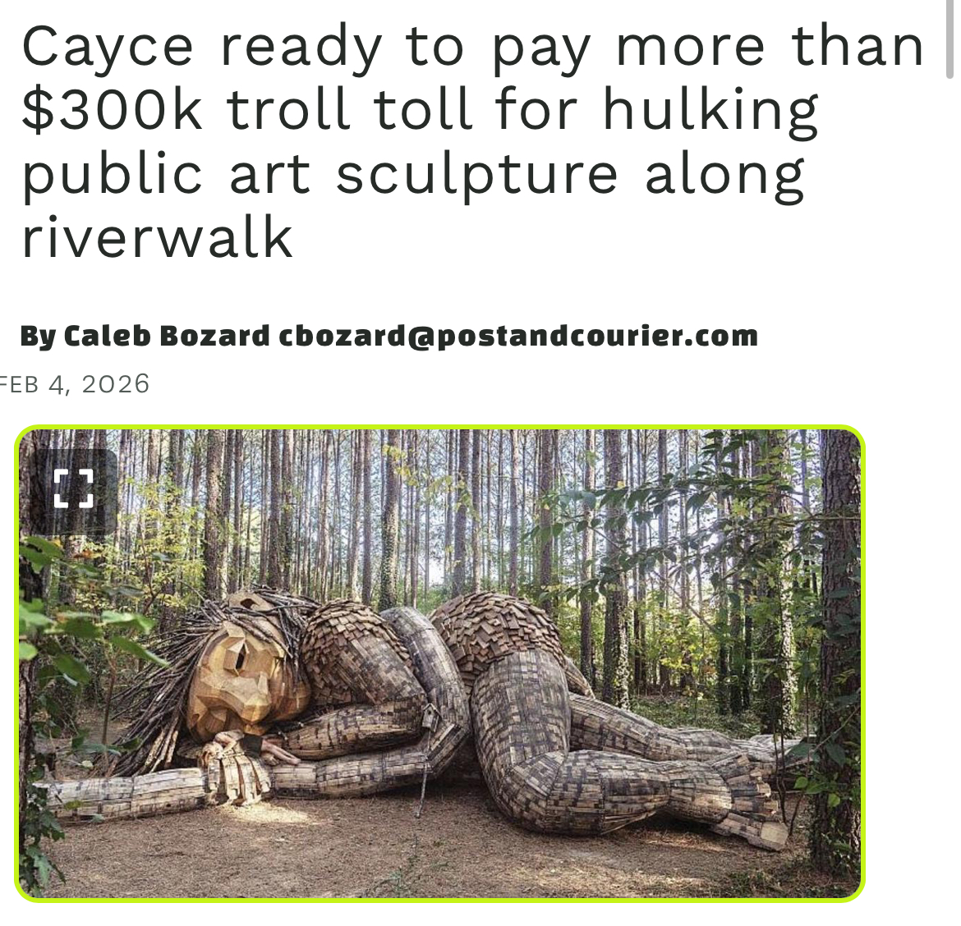
Case Study 3 – Troll Money
Metrics
1,000 + Interactions
371 Shares
Comment count unavailable
Basic Stats
13,000 to 14,000 residents
Situated along the Congaree River
Housing is 47% lower than national average
Notes:
Recommended font style and sizes for legibility
Title text: Arial, 36pt, all caps
Body text: Arial, 24pt-28pt

Slide 22
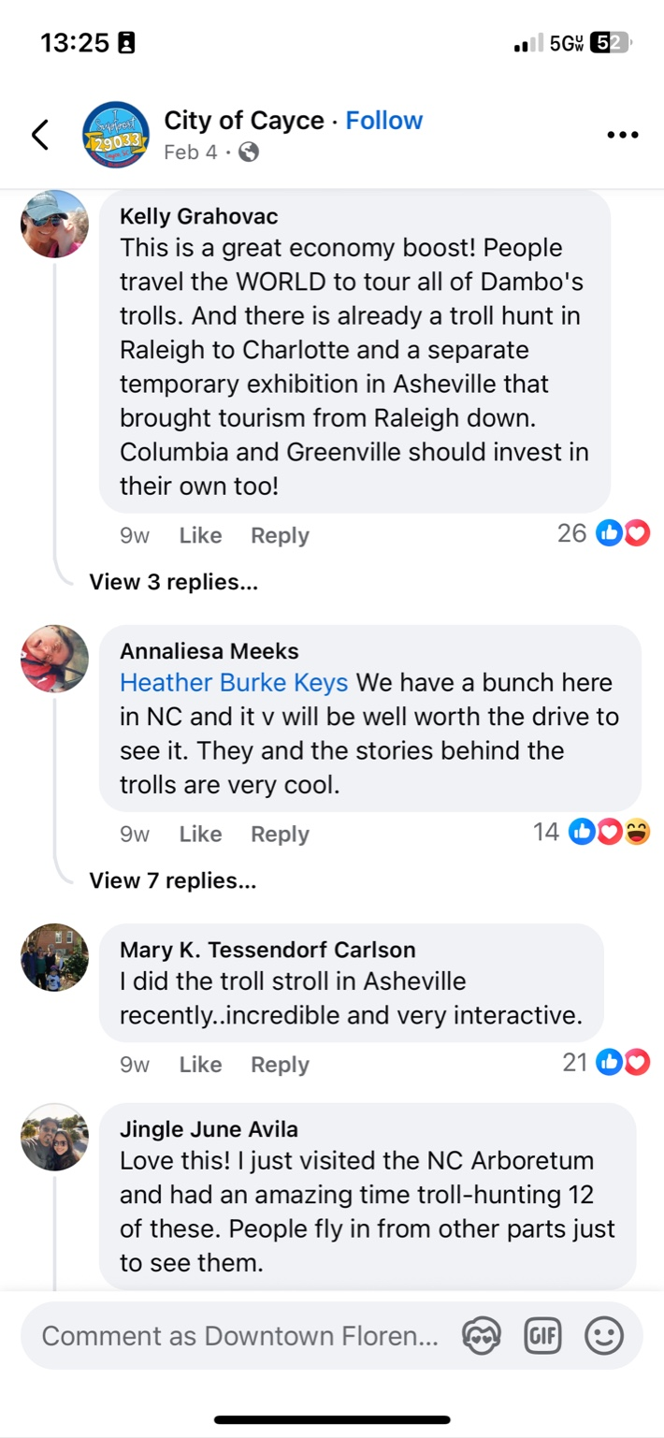
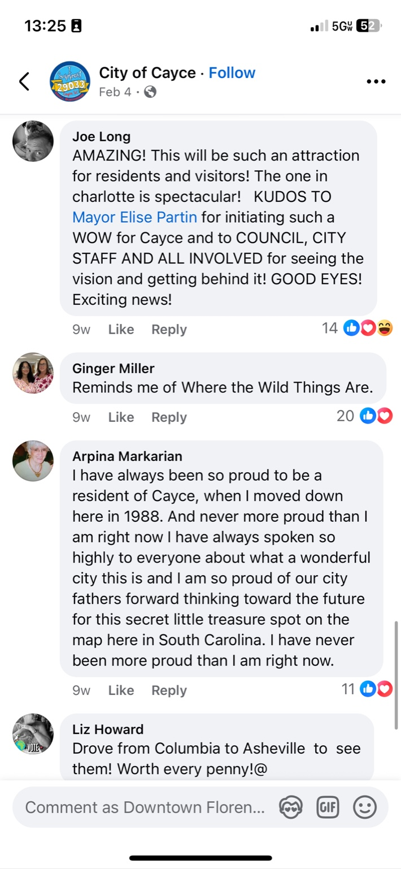
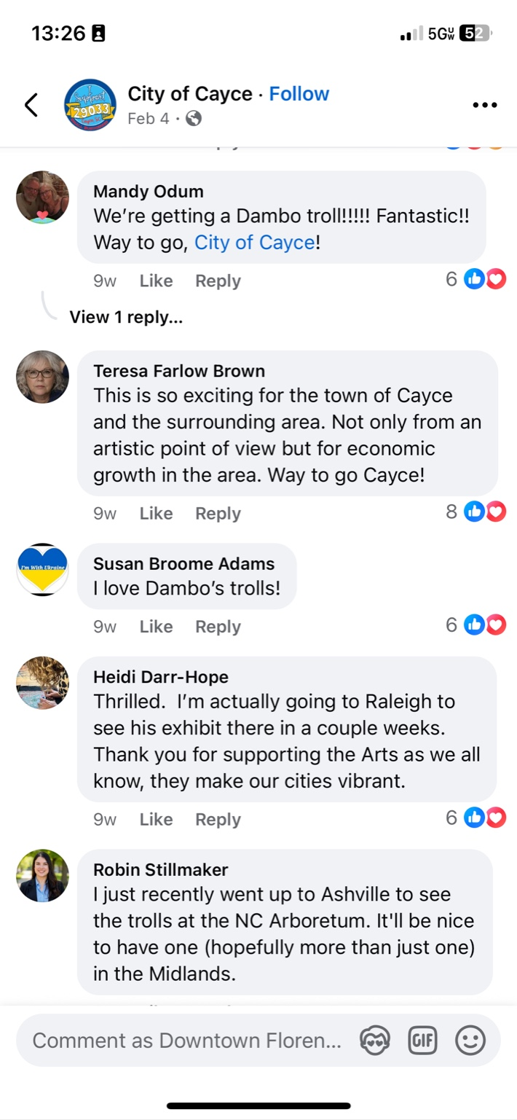
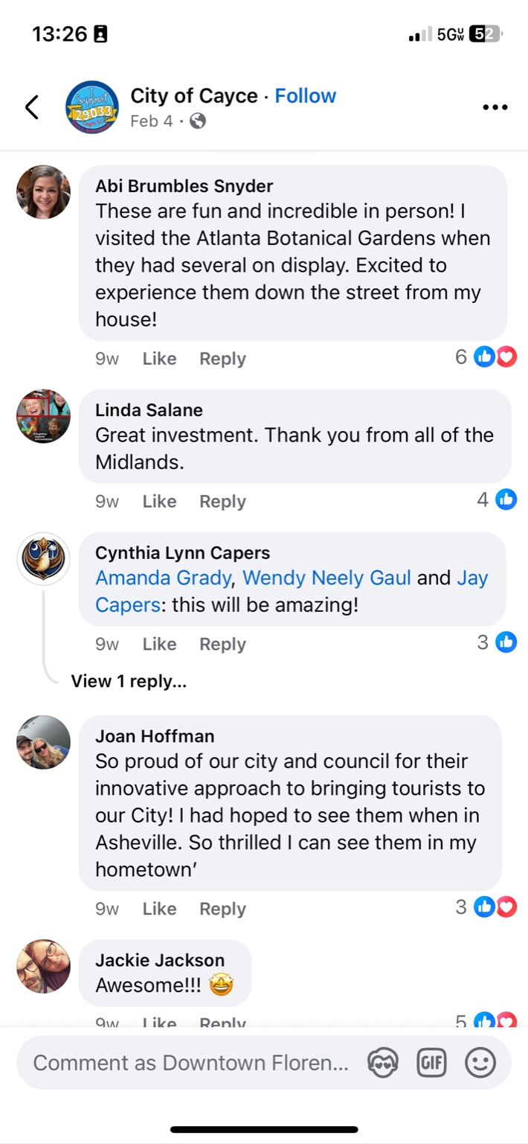

Slide 23
C.3 Not Backlash, Support?
No Backlash
Strong alignment
Shared understanding
Clear Expectations – no ambiguity
Tourism, pride, economic impact, community values
Theory in Action
Inoculation: The message was quick, not reactive. Value was understood early
Social Judgment: The message reach beyond just supporters, comments were positive early on
Cognitive Dissonance: Project and message aligned with existing beliefs, community pride
When meaning is clear, people don’t have to guess

Slide 24
Backlash isn’t about the project. It’s about the gap between what you say and what people understand

Slide 25
Crafting Communication

Slide 26
Crafting the Message
Most Messages Answer:
What is happening
Strong Messages Answer:
Why it matters
What is means for “me”
What happens now/next
Anticipate Concern
Name what people might feel
Frame it before others do
Notes:
Most of us are really good at sharing information
“Here’s what’s happening. Here’s the data. Here’s the project”
Information alone doesn’t stop backlash, backlash isn’t about the information. It’s about the interpretation.
Simply put, every message you craft that your audience sees is subconsciously asking three questions.
Why does this matter?
How does it affect me?
Is this good or bad for what I care about?
Again, if all we say is what, our audience will fill in the rest.
When crafting a message, you need to move beyond just announcing and start intrepeting
Think about your message in four parts
What is happing (announcement)
Why it matters (purpose)
What it means for them (impact)
What comes next (clarity)
Example “We’re excited to announce a new streetscape project begging next month”
Bad.
Instead
“We’re beginning a streetscape project next month designed to improve walkability and support local businesses. We know construction can be disruptive, here is what you can expect and how we’re working with contractors and businesses owners to minimize impact”
So, we added meaning, acknowledged concern, gave context, and reduced uncertainty. When this is done well you’ve inoculated audiences early, you’ve spoken to more than just your supporters, and you’ve made it easier for the message to be accepted instead of push against it.

Slide 27
Know your Audience
Arnett Muldrow 5 Audiences of Main Street
Donors
Owners
Public
Volunteers / Supporters
Government
Businesses
Impact, traffic, revenue
Residents
Identity, lifestyle, change
Visitors
Experience & appeal
Notes:
When crafting a message, you want to have a specific audience in mind for the bulk of the message. When we try to make our communication universal it ends up falling flat with everyone.
HOWEVER
It is a double edge sword when we communicate via social media since all audiences have access to that. You want to keep your main audience the focus, with some care for the other audiences that may likely see the content. This does change depending on the avenue you choose to communicate through. An email to your businesses prior to a major announcement may prove beneficial.
But, don’t wait several days to inform the public. Think of it like a heads up. Give them the option to reach out to you directly if they questions or concerns. Your business community can be your greatest supporters or your worst enemies.

Slide 28
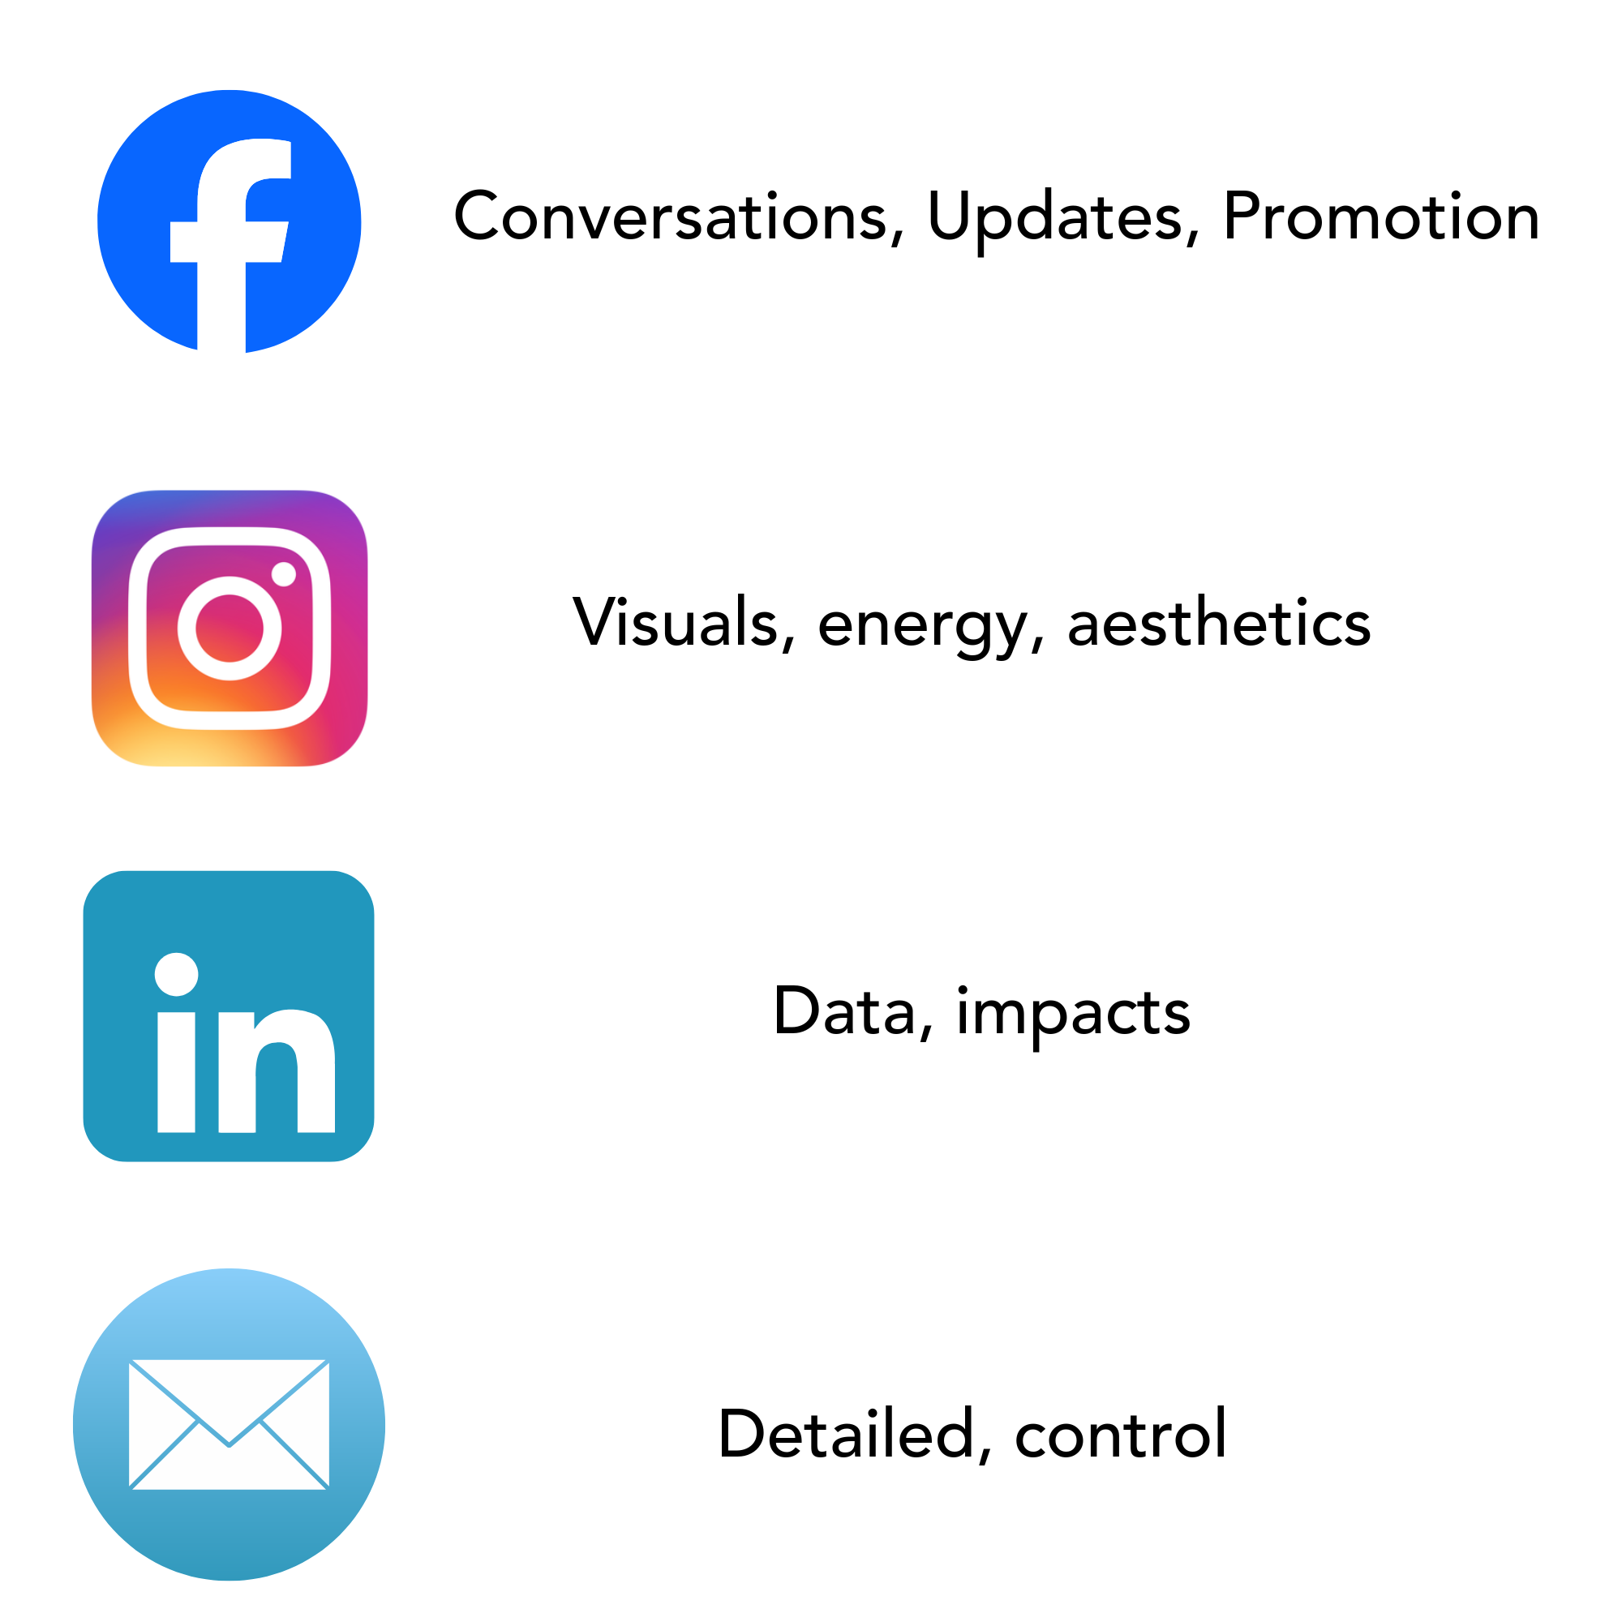
Choose the Right Channel
Notes:
Facebook and Instagram can share an audience so cross messaging is expected, but industry standards would agree that what you post on facebook and Instagram should be different. Same message, different delivery
Linkdin is where your professional, developers, big wigs are. The people with the access and capital to make big changes in your town are more likely to see your content here. They’re opinion is also less likely to be impacted negatively on this channel. Additionally, things like tax incentives and large data points will make more sense to the audience here as they will likely have a better appreciation for the numbers and what they mean.
Email is targeted and direct. People on an email list are likely already invested in what you are doing, emails are a way to maintain that support and help them feel like insiders.
Note: You don’t have to have all of these communication avenues.

Slide 29
Before You Post & After
The Message
Responding to Backlash
Inoculation What needs to be said early?
Social Judgment Who will resist and why?
Cognitive Dissonance What belief does this challenge?
Context → Name → Validate → Reframe
Context → What’s happening Name → What you’re hearing Validate → Why it makes sense Reframe → What it means
Notes:
If you can predict the comments, you can prepare the message.
You’re not trying to win the argument; you’re trying to preserve trust.
Note: It’s hard to take the personal out of message, but, the argument isn’t about you. The audience isn’t mad at you, they’re mad/confused about the situation.
When backlash happens, take a moment to hear what your community is saying. Backlash provides data and insights into your community's value systems, wants, and fears. This will help you prepare in the future.
You will get this wrong in the beginning and probably after. Intrest and values shift, your communication needs to shift with it.

Slide 30
TAKEAWAYS
If you don’t define meaning, your audience will.
Early communication isn’t extra, it’s insurance.
Speaking only to supporters cost you the middle.
Confusion fuels backlash. Clarity builds trust.
Notes:
Recommended font style and sizes for legibility
Body text: Arial, 24pt-28pt

Slide 31
Austin Watters
Downtown Development Coordinator, Downtown Florence, SC
awatters@cityofflorencesc.gov
Notes:
Recommended font style and sizes for legibility
Name text: Arial, 48pt
Title & organization text: Arial, 28pt

Slide 32



Please review this session on the Mobile Event Guide:
Download the “Main Street Now 2026” app
Locate this session and scroll to “Session Feedback”
Complete your review
Need help? See your conference program or a volunteer for assistance.

