Slide 2

Vivian Best
UNLEASHING THE WEAVER IN YOU
Educator and Community Weaver,
Weave: The Social Fabric Project

Slide 3
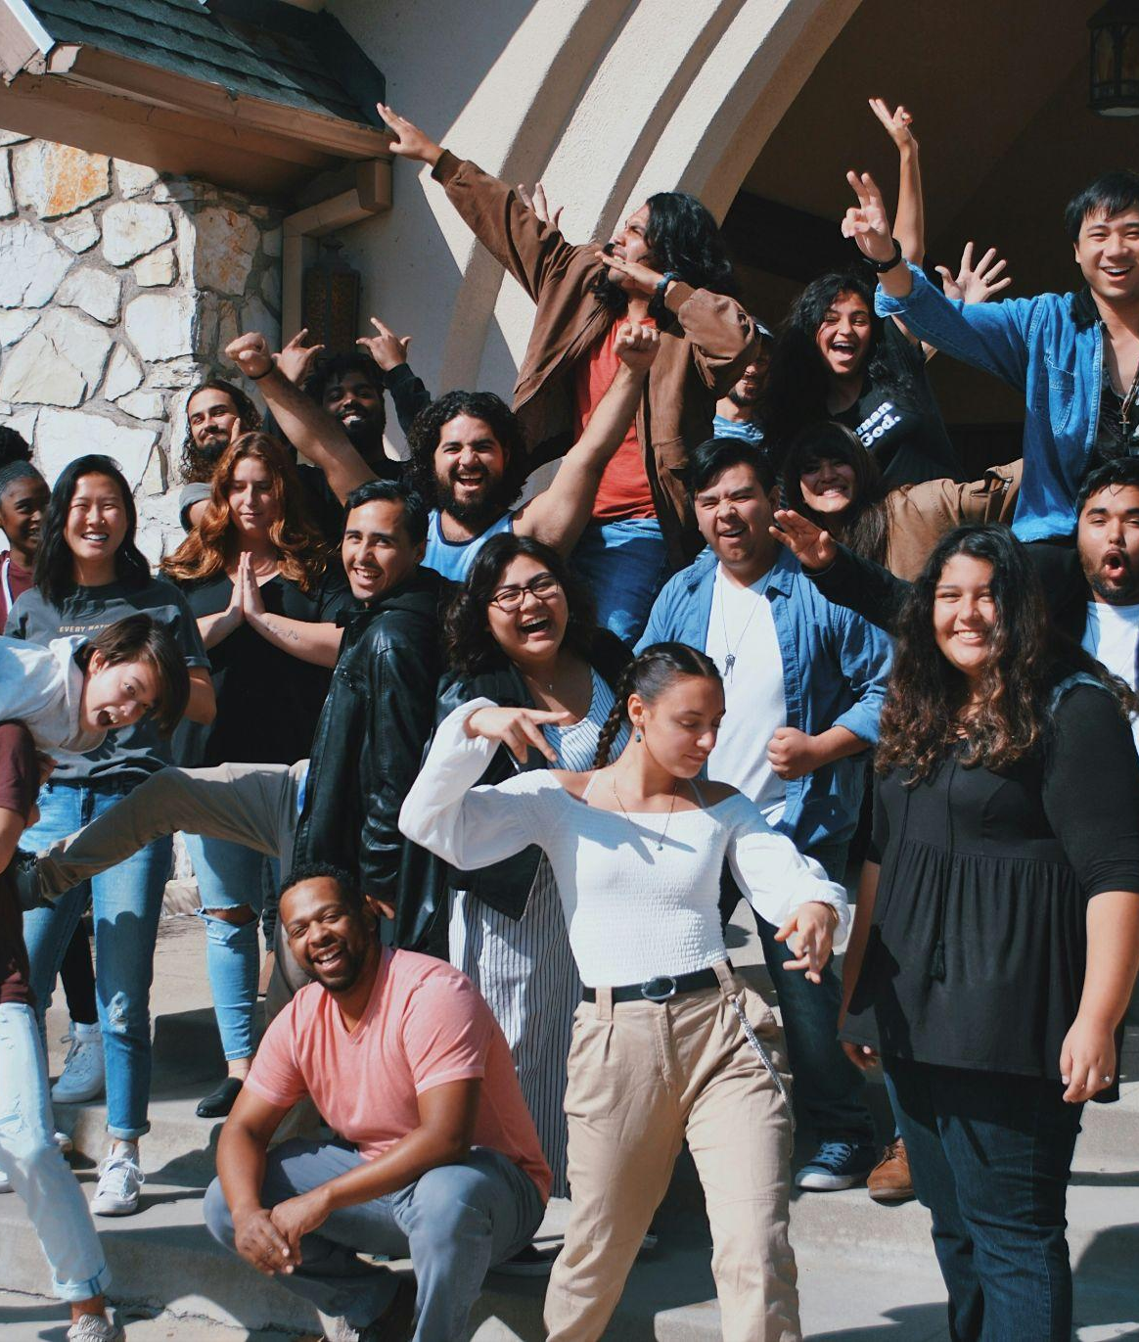
Weaving Trust and Connection on Main Streets
Photo by Joel Mott on Unsplash

Slide 4
AGENDA
Weaving Trust and Connection on Main Streets
Vulnerability and Active Listening
What’s Your Why?
ABCD Gifts Inventory
Reflection/Closing

Slide 5
Group Agreements
Be present.
Share from the head and the heart.
Keep what is shared in confidence.
Listen deeply. No cross talk or questions while listening!
Be curious — don’t advise, consult, solve or judge.

Slide 6

Vulnerability and Active Listening
Notes:
Recommended font style and sizes for legibility
Body text: Arial, 40-44pt

Slide 7
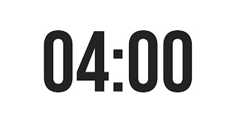
Relational 1:1s
In pairs, listen to your partner without interruption. Listen for shared values and themes.
What activity do you find yourself losing all track of time while you are doing it?
What talent or skill does it give you the most joy to give or share?
What do others tell you they most appreciate about you as a friend, colleague or family member?

Slide 8
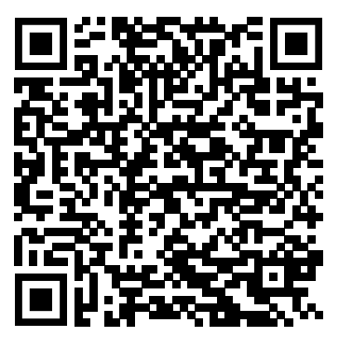
TAKEAWAYS
What was that like?
What made you feel listened to?
What values did you share?
Can you think of someone who you’d like to learn more about in this format? Explore Relational 1-1’s Tool at Weave site!
Notes:
Recommended font style and sizes for legibility
Body text: Arial, 24pt-28pt

Slide 9
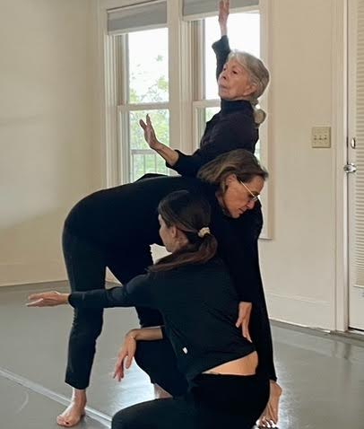
“How we spend our days is of course, how we spend our lives.”
-Annie Dillard
What’s your WHY?
Notes:
Recommended font style and sizes for legibility
Body text: Arial, 40-44pt

Slide 10
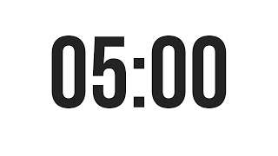
What’s your Why?
Take 5 minutes to reflect on these questions:
Write as many “I believe…” statements as possible. What is your cause? What are your core beliefs? What’s important to you?
If you left your job or community tomorrow, what is the one thing that you’d be devastated to see stop happening in your absence?
What is the one problem in your community or organization that you can’t help but try to fix, even if it’s not in your job description?

Slide 11
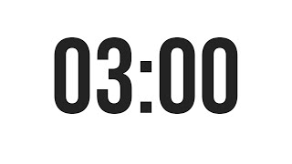
What’s your Why?
With a different partner, share for three minutes each with your responses from the last activity. (You’ll have two minutes to chat after both of you have gone!)
You can also use this prompt when sharing with your partner.:
“I do this….. SO THAT…..”

Slide 12
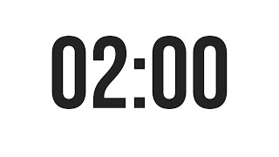

Slide 13
What’s your Why?
Please share your WHY with the whole group as if we are the EXACT audience that needs to hear it!

Slide 14
TAKEAWAYS
What was that like?
How is it helpful to understand your WHY?
How was it helpful to hear and understand others’ WHYs?
Where would it be helpful for others in your community to hear their own and others’ WHYs?
Notes:
Recommended font style and sizes for legibility
Body text: Arial, 24pt-28pt

Slide 15
Your WHY can be support for you when things get challenging.
Notes:
Recommended font style and sizes for legibility
Body text: Arial, 50-54pt

Slide 16
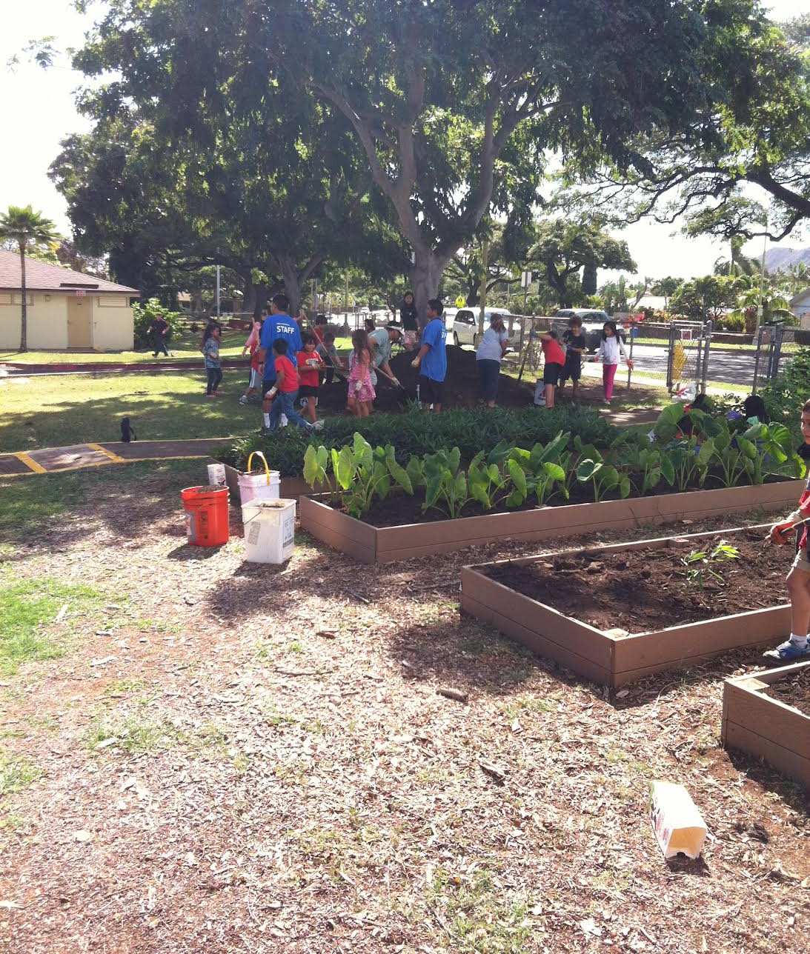
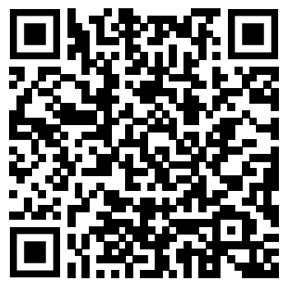
Asset Based Community Development
Guiding Beliefs:
Notes:
Recommended font style and sizes for legibility
Body text: Arial, 40-44pt

Slide 17

Use this slide to break up content and add an important point.
Head (Knowledge):
Do you have knowledge or education on a particular topic?
This includes learning, organizational capacity and skills related to thinking and planning
Notes:
Recommended font style and sizes for legibility
Body text: Arial, 32pt

Slide 18

Use this slide to break up content and add an important point.
Hands (Skills):
What skills do you possess that you would enjoy sharing with the community or teaching others?
This includes physical gifts, talents, and abilities!
Notes:
Recommended font style and sizes for legibility
Body text: Arial, 32pt

Slide 19
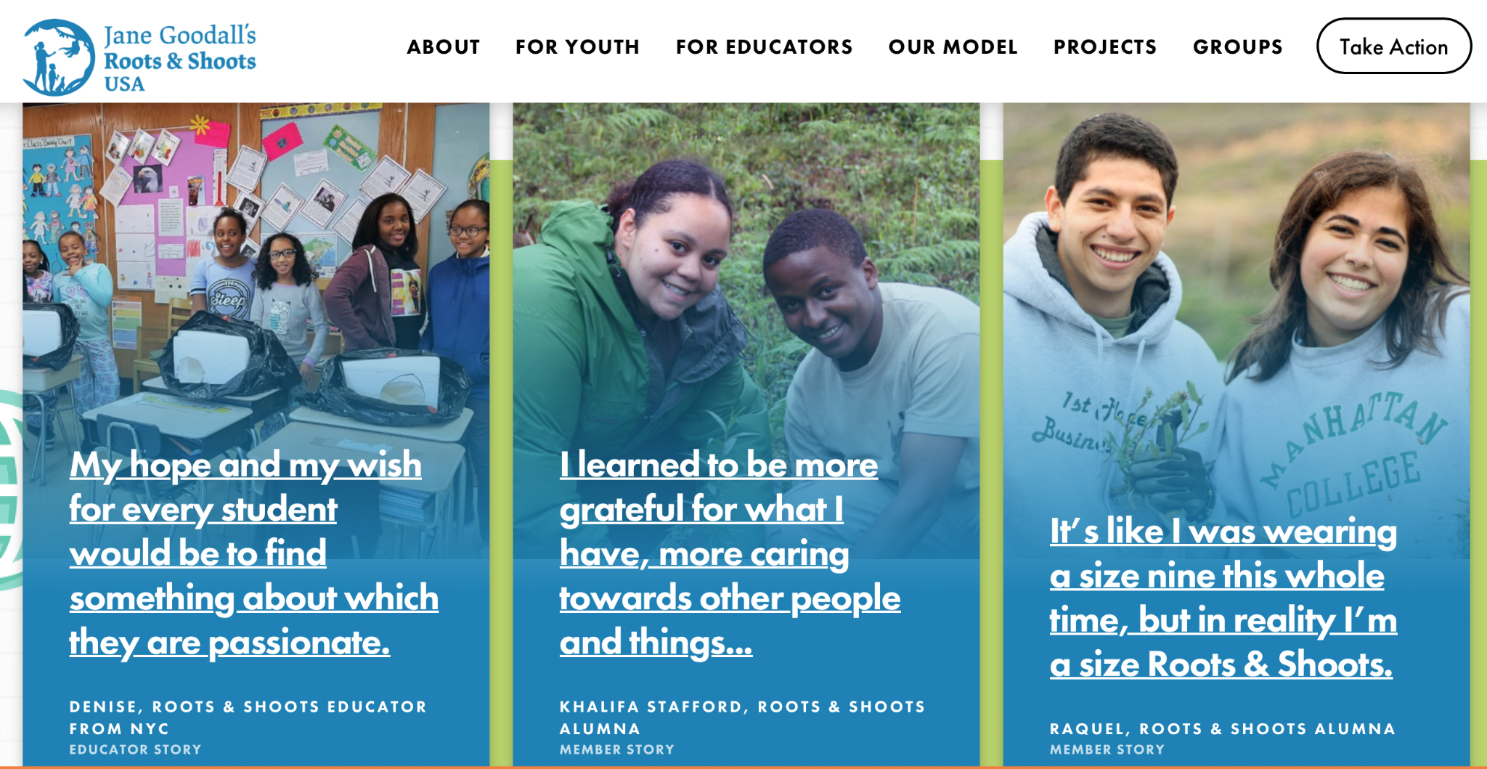
Heart (Passions):
What do you care about that has the power to stir you to action?
Heart (Passions):
What do you care about that has the power to stir you to action?
Notes:
Recommended font style and sizes for legibility
Body text: Arial, 32pt

Slide 20
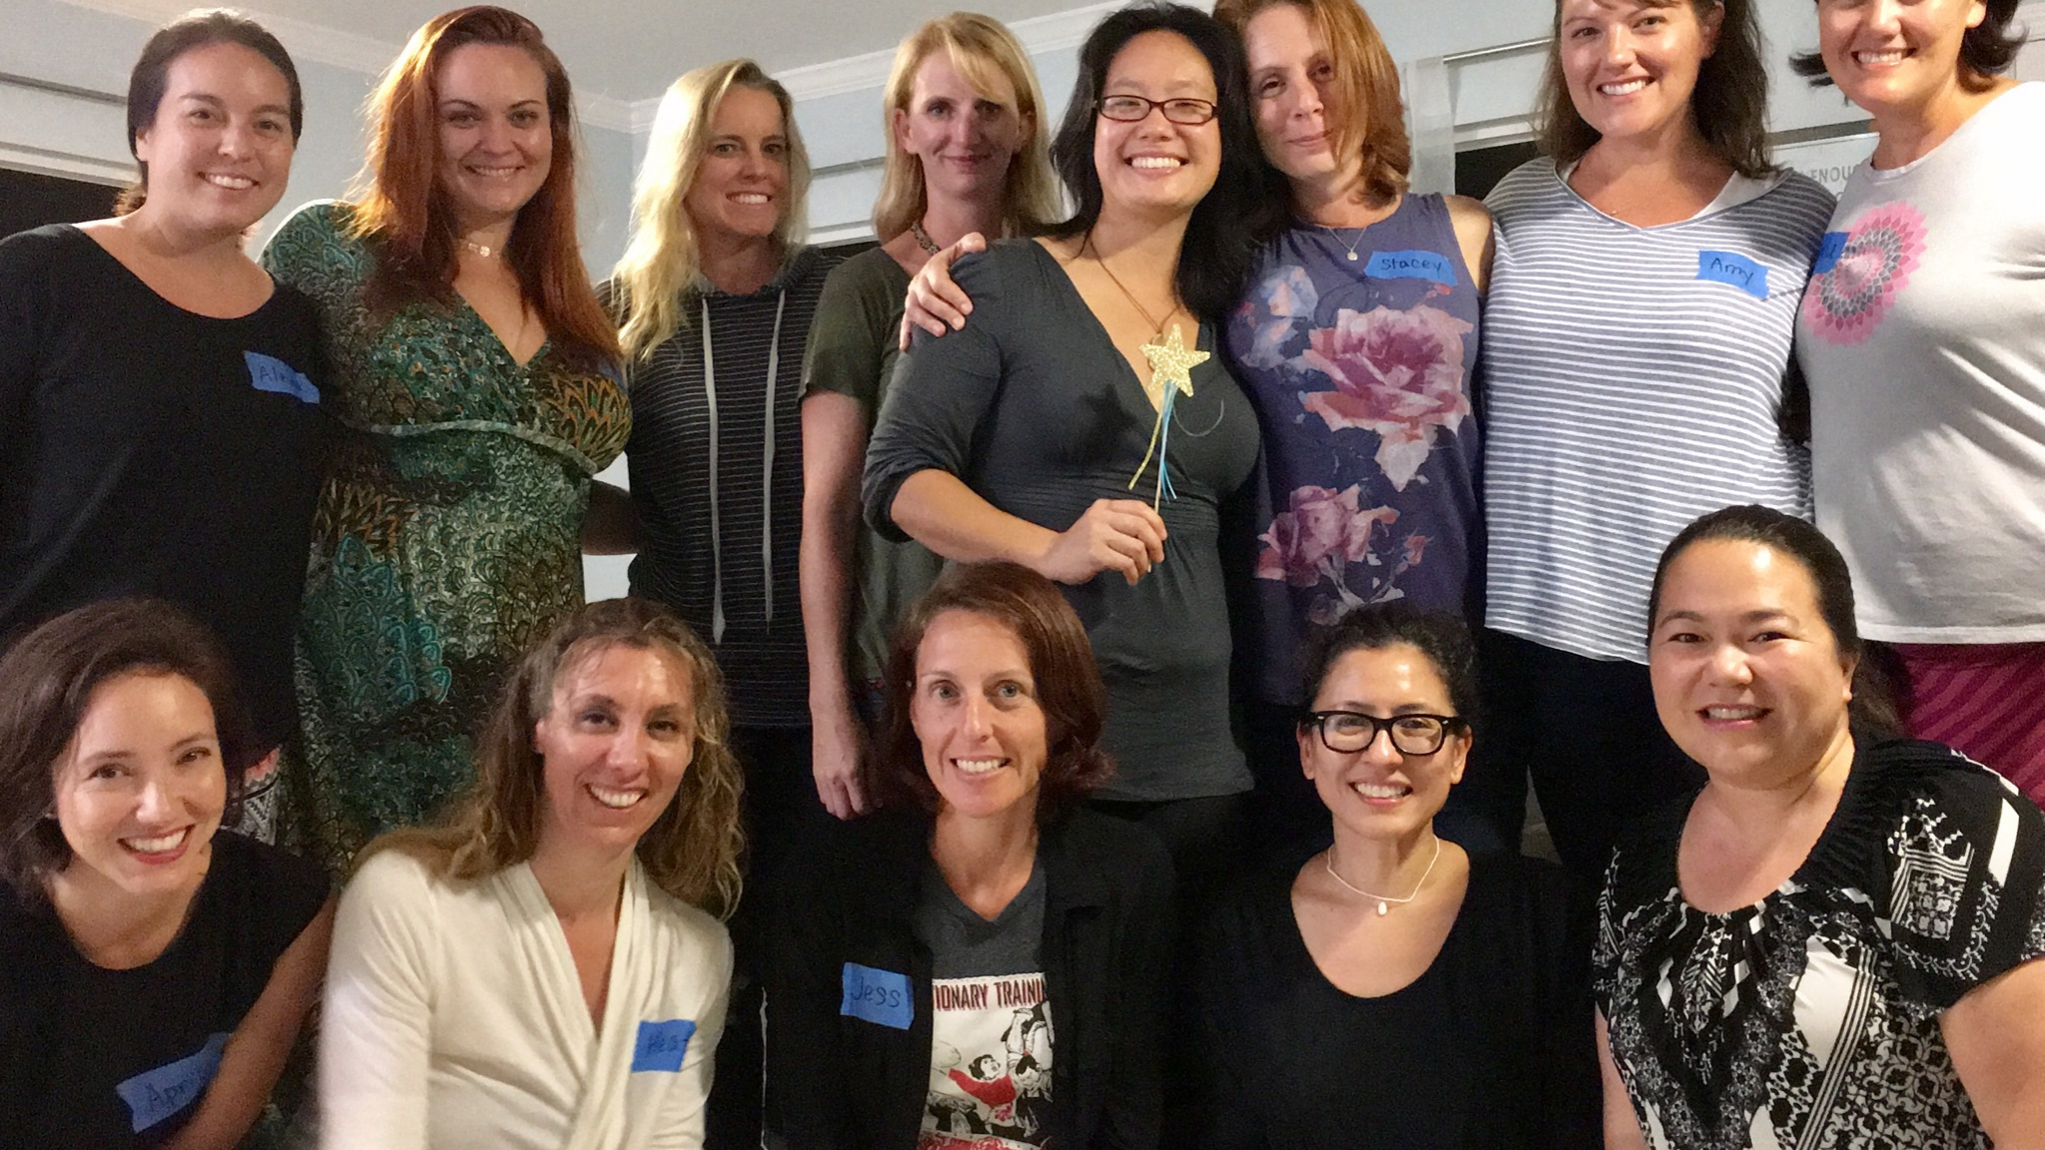
Use this slide to break up content and add an important point.
Human Connection (relationships):
How are you good with connecting with people or connecting people with other people?
What do you do to stay connected to your community?
Notes:
Recommended font style and sizes for legibility
Body text: Arial, 32pt

Slide 21
Gift Categories:
Head (knowledge): Do you have knowledge or education on a particular topic?
Hands (skills): What skills do you possess that you would enjoy sharing with the community or teaching others?
Heart (passions): What do you care about passionately that has the power to stir you to action?
Human connection (relationships): How are you good at connecting with people or connecting people with other people? What are the things you do to stay connected to your community?
Take 5 minutes to list your gifts.
Notes:
Recommended font style and sizes for legibility
Title text: Arial, 36pt, all caps
Body text: Arial, 24pt-28pt

Slide 22
Gift Categories:
With a different partner, share for two minutes each about your responses from the last activity. (You’ll have a minute to chat after both of you have gone!)
Notes:
Recommended font style and sizes for legibility
Title text: Arial, 36pt, all caps
Body text: Arial, 24pt-28pt

Slide 23
TAKEAWAYS
What was that like? What did you notice?
How is it helpful to understand your gifts? Share about a gift in yourself that you may have taken for granted.
How was it helpful to hear and reflect on others’ gifts?
Notes:
Recommended font style and sizes for legibility
Body text: Arial, 24pt-28pt

Slide 24
After the conference, you may want to write a note and acknowledge someone whose gifts have touched you recently!
Notes:
Recommended font style and sizes for legibility
Body text: Arial, 50-54pt

Slide 25
TAKEAWAYS
What would it look like to lift up everyone’s gifts and WHYs?
What are you taking away from our time together today? How can you take this into your community?
Notes:
Recommended font style and sizes for legibility
Body text: Arial, 24pt-28pt

Slide 26
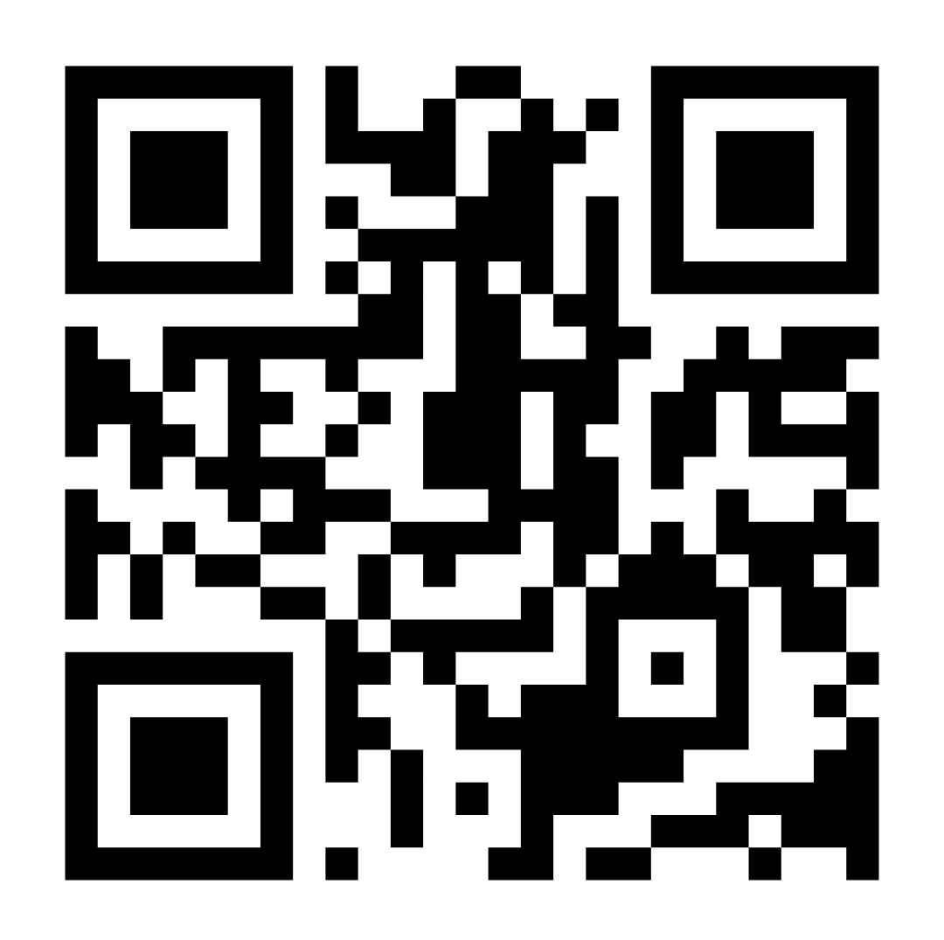
Connect with weavers and find free resources, courses, and more.
Weaving.Us
Notes:
Recommended font style and sizes for legibility
Body text: Arial, 50-54pt

Slide 27
Please review this session on the Mobile Event Guide:
Download the “Main Street Now 2026” app
Locate this session and scroll to “Session Feedback”
Complete your review
Need help? See your conference program or a volunteer for assistance.

Slide 28
CLOSING
Main Street Survey
Closing poem by Lucy Dubose
Something from above,
and something from below, beckons me
To befriend myself, all others, and the earth.
Notes:
Recommended font style and sizes for legibility
Body text: Arial, 24pt-28pt

Slide 29
Vivian Best
Educator and Community Weaver
Cultivatingpossibilities@gmail.com
Weave: The Social Fabric Project Weaving.Us
Notes:
Recommended font style and sizes for legibility
Name text: Arial, 48pt
Title & organization text: Arial, 28pt

